Slide 1
Edge Computing
Lecture 04: Edge Systems: Design and Optimization

Slide 2
Recap
The IoT Challenge
Bandwidth, latency, throughput, pipeline
Generic metrics, must specify context,
e.g. Packet latency vs execution latency/time
e.g. Link throughput vs frame throughput (FPS)
Example system architectures
Edge-heavy vs Cloud-heavy apps
Close-the-loop: sensing, compute, actuation
Decision making

Slide 3
Agenda
Edge System Design and Evaluation
Edge System Optimization
Multi-threading & Multi-processing
Quiz 2

Slide 4
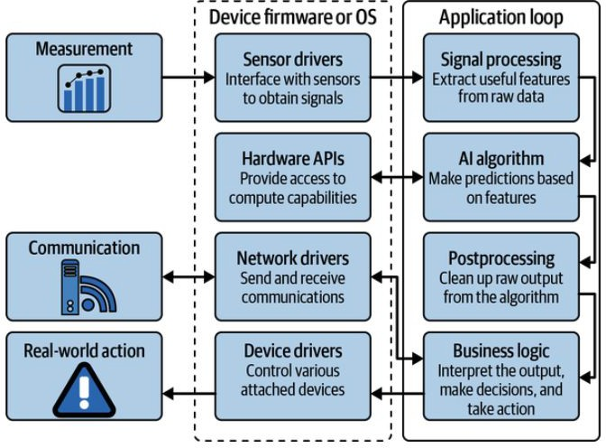
System Design Tips
Component function
Logical connection
Draw a good diagram if possible
Situnayake, D., & Plunkett, J. (2023). AI at the Edge. O'Reilly

Slide 5
System Optimization: Evaluation Metric
What to optimize?
What do you care?
How would you measure?

Slide 6
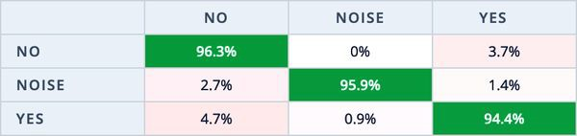
Metrics
Google it!
Accuracy
System
FPS
Throughput
Latency
Memory
Energy
Thermal
TOPS/FLOPS
Loss
Confusion Matrix
True/False Positive/Negative
Precision & Recall
RUC curve (TP vs FP)
mAP (mean Average Precision)
Area under precision vs recall curve
Error
IoU
Mean absolute error (MAE)
Squared MSE/RMSE
ADE (abs. distance error)

Slide 7

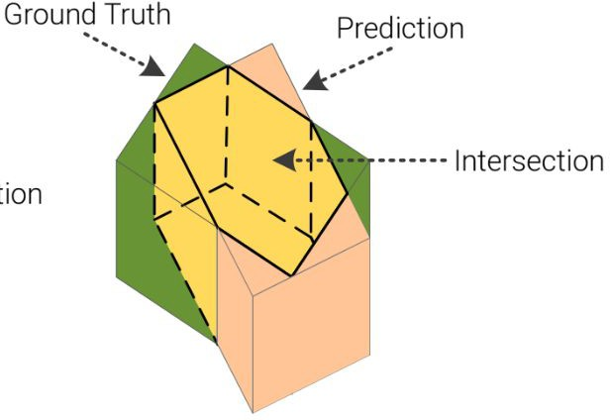
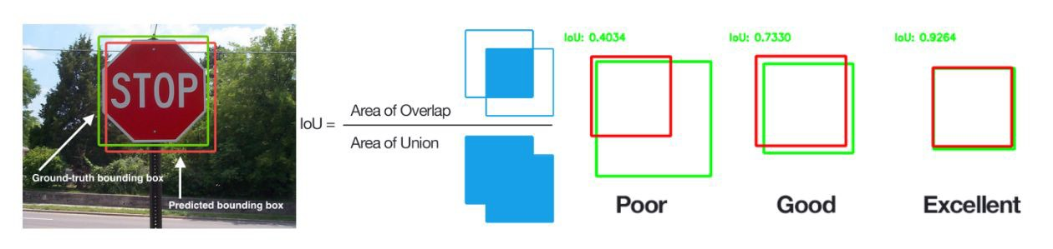
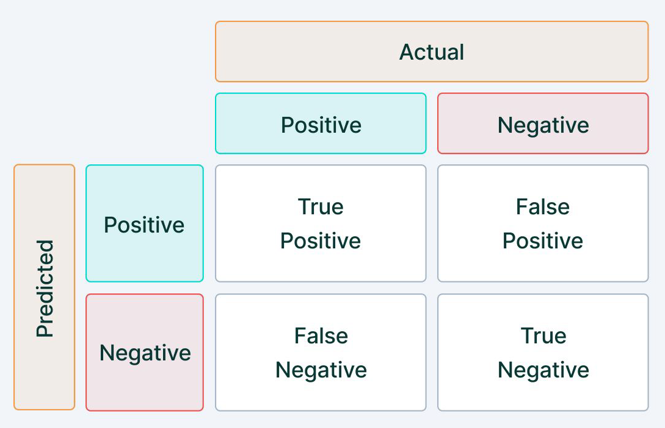
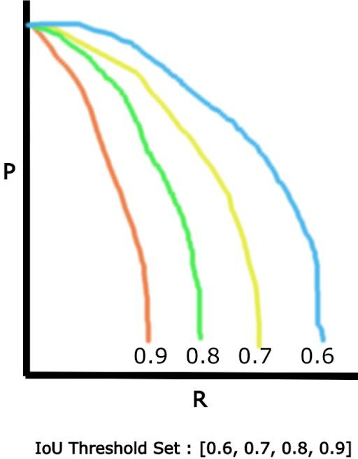
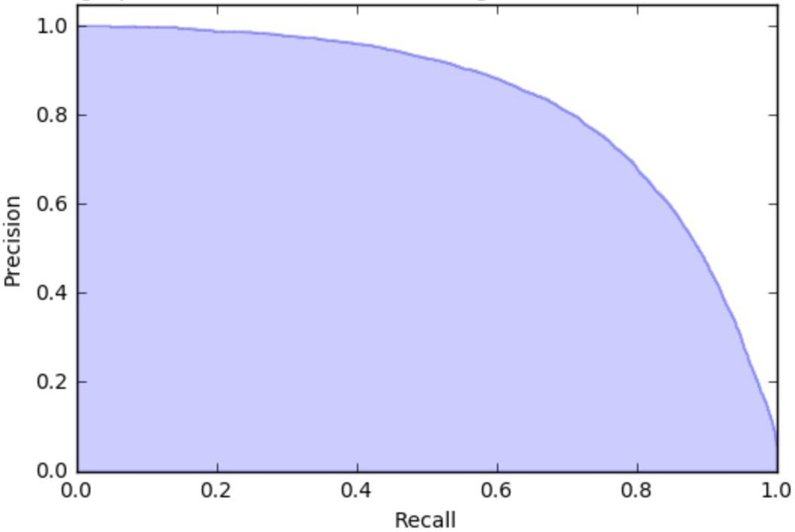
Detection Task and Evaluation Metric
Task
Produce a set of boxes for the objects in the scene Metric
Intersection-over-Union (IoU)
True/False Positives (TP/FP)
True/False Negatives (TN/FN)
Precision/Recall (P/R)
PR Curve
Average Precision (AP)
src1, src2

Slide 8
Optimization
Design time
Topology, device, resource
Deployment time
Evaluate system metrics
Workload balancing between edge and cloud
Run time
Evaluate performance metrics at scale
Monitoring and supporting

Slide 9
Edge Device Optimization
Facing limits, what can we do?
Establish baseline (existing technique, or naive implementation)
Algorithm refinement
Design tradeoff
Implementation tailored to hardware

Slide 10
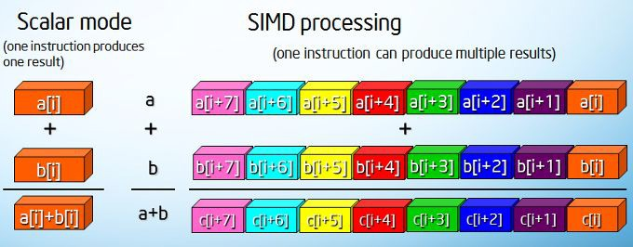
SIMD: Single Instruction/Multiple Data

Slide 11
Concurrency: Thread & Process
Google it!
Thread
○
Process
○

Slide 12
Concurrency: Thread & Process
A thread is a sequence of instructions within a process. It can be thought of as a lightweight process. Threads share the same memory space.
A process is an instance of a program running in a computer which can contain one or more threads. A process has its independent memory space.

Slide 13
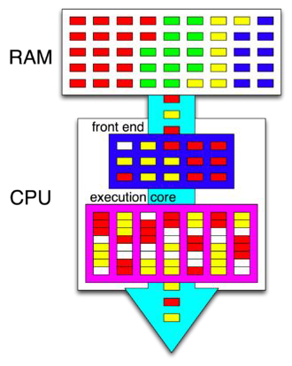
Hyper-threading
One form of multi-threading
Each color is a process / thread
Each box is an instruction
Frontend blends / reorders the instructions
Core process instructions from different colors simultaneously
White boxes meaning empty resources
https://en.wikipedia.org/wiki/Hyper-threading#:~:text=Hyper%2Dthreading%20(officially%20called%20Hyper,once)%20performed%20on%20x86%20microprocessors.

Slide 14
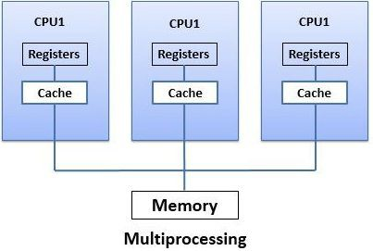
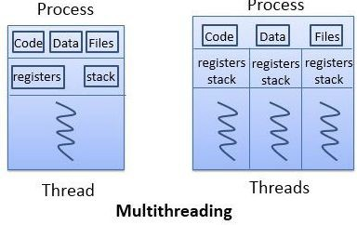
Multi-Threading & Multiprocess
Let’s go to Colab: Profiling performance.ipynb

Slide 15
Summary
Edge System Evaluation
System Metrics vs Performance Metrics
Edge System Optimization
Architecture design
Device optimization
Concurrency
SIMD
Threading & Multiprocessing

Slide 16
Next Lecture
Basics of ML
Lab 2: object detection
ML footprint optimization: pruning and quantization

